Slide 1


WAVECON TELECOM ANALYSIS
Presented by: Manju

Slide 2
Data Summary ( Year – 2022)
1
2
3
4
<5G
Jan
Feb
Mar
Apr
May – 5G Implementation
6
7
8
9
>5G
Jun
Jul
Aug
Sep

Slide 3
What is the impact of 5G launch on revenue?
Which KPI is underperforming after 5G launch?
After the 5G launch, which plans are performing well in terms of revenue? Which plans are not performing well?
Objectives
Is there any plan affected largely by 5G launch and should we continue or discontinue the plan as a result?
Is there any plan which is discontinued after the 5G launch, if yes then what is the reason for it?

Slide 4
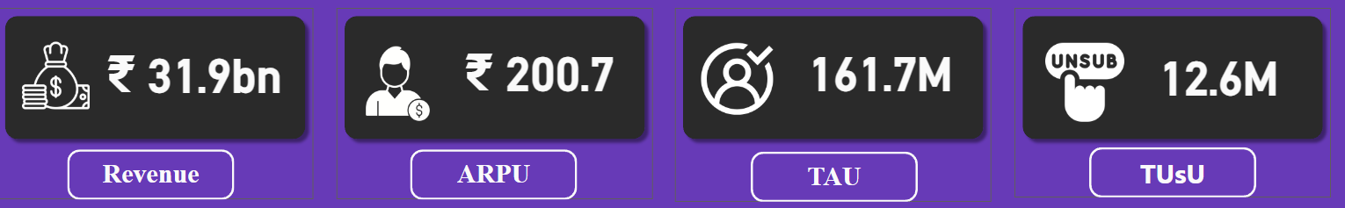
MAIN KPI’S
Wavecon generated total revenue of 31.9 bn
ARPU (Average Revenue Per User) - Rs.200
TAU (Total Active Users) – 161.7M
TUsU (Total Unsubscribed Users) – 12.6M

Slide 5

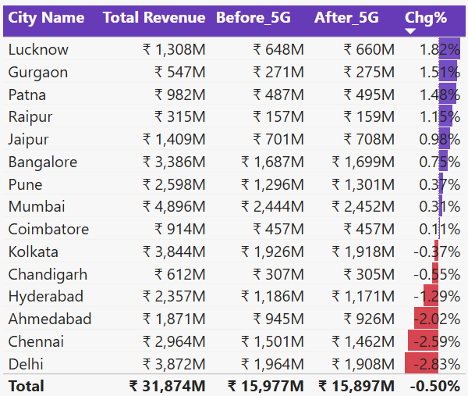
1.What is the impact of 5G launch on revenue?
Revenue before5G 16.00 bn
Revenue after 5G 15.90 bn
Revenue change% -0.50%
Revenue dropped by 0.5% after the 5G launch, mainly because revenue in Delhi fell by 5%
Delhi, Chennai, Ahmedabad, Hyderabad, Chandigarh, Kolkata cities revenue has declined after the 5G launch
With a nearly 1.48% revenue increases, Lucknow, Gurgaon, Patna are the top 3 cities with the most revenue changes seen
In terms of total revenue, Raipur contributes the least amount of overall revenue, while Mumbai contributes the most with over 4800M

Slide 6

2. Which KPI is underperforming after 5G launch?
After the introduction of 5G, two Key Performance Indicators (KPI) have been identified as underperforming
Active Users
Unsubscribed Users

Slide 7

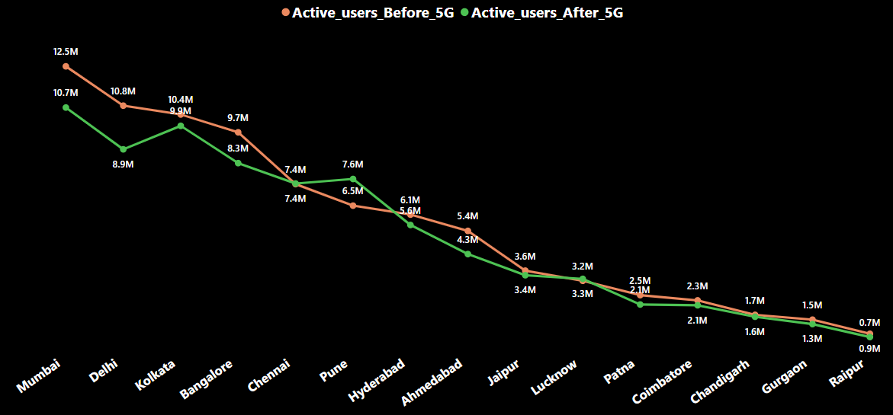
Active Users
Total Active Users 162M
Active Users before 5G 84.4M
Active Users after 5G 77.4M
Active Users chg% -8.28%
After 5G launch, Pune is the only city which increased by 17% in Active Users, while Chennai remains unchanged
Mumbai and Delhi is the most affected cities after the 5G launch having decreased by 14.4% and 17.5% in Active Users respectively
It would be beneficial to conduct survey in these two cities to investigate the reasons behind the decline in active users

Slide 8

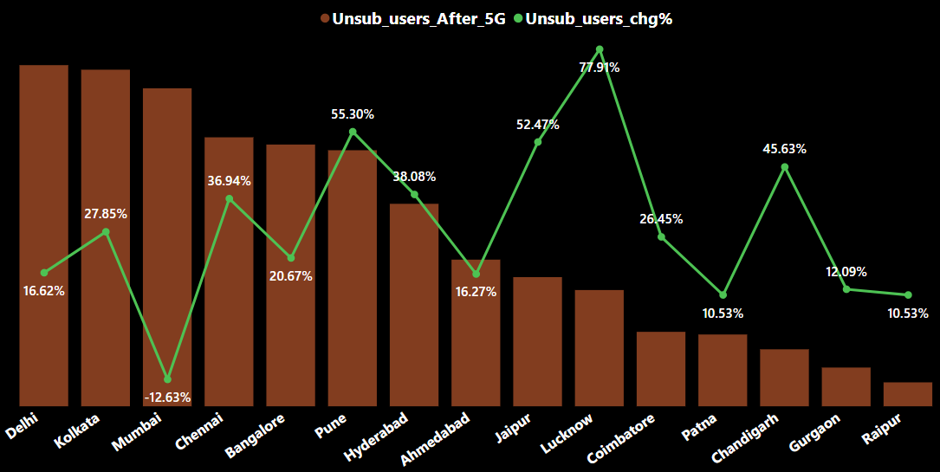
Unsubscribed Users
Total Unsubscribed Users 12.6M
Unsub Users before 5G 5.6M
Unsub Users after 5G 7M
Unsub Users chg% 23.50%
The line and column chart shows the percentage change in unsubscribed users after the implementation of 5G, with Lucknow city experiencing as 77.9% increase in unsubscribed users which is highest among all the cities
Mumbai is the only city which is decreased by 12.63% in the unsubscribed users

Slide 9
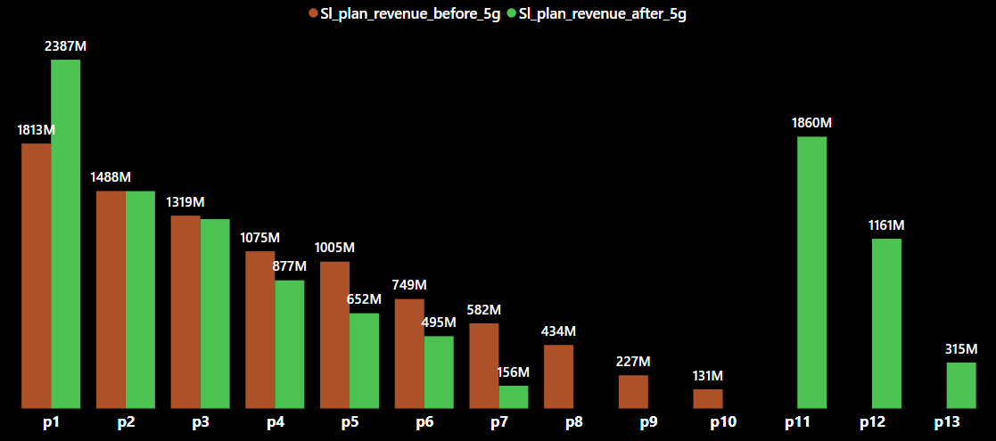
3. After the 5G launch, which plans are performing well in terms of revenue? Which plans are not performing well?
Plan p1 is the best performing plan after the 5G launch showing an increase of 24.05% in revenue.
Where, p2 and p3 plans not shown any significant decrease or increase
Revenue for plans p4, p5, and p6 has declined.
Plan p7 experienced a major decrease in revenue, dropping from 582M to 156M.
The company discontinued plans p8, p9, and p10 with the introduction of new plans p11, p12, and p13.

Slide 10
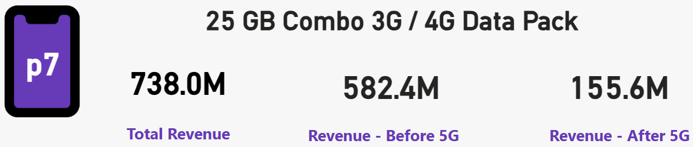
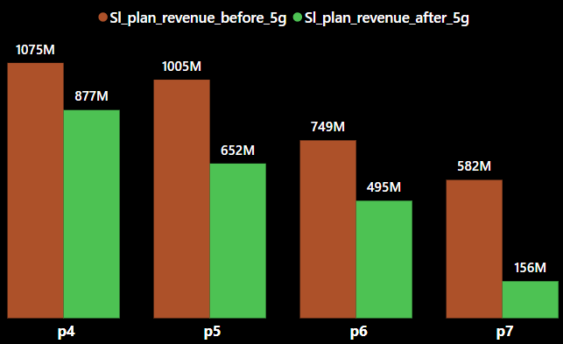
4. Is there any plan largely affected by 5G launch, if yes then should we continue or discontinue the plan?
After 5G launch, the revenue for plan p7 has dropped significantly, from 582.4M to 155.6M, so it should be discontinued
There has been a slight decline in revenue for plans p4, p5 and p6 and we can make a few modifications to improve them or if these plans follow same trend as p7 then these plans should also be considered to be discontinue in future
The common factor among these plans is that they are short-duration plans

Slide 11
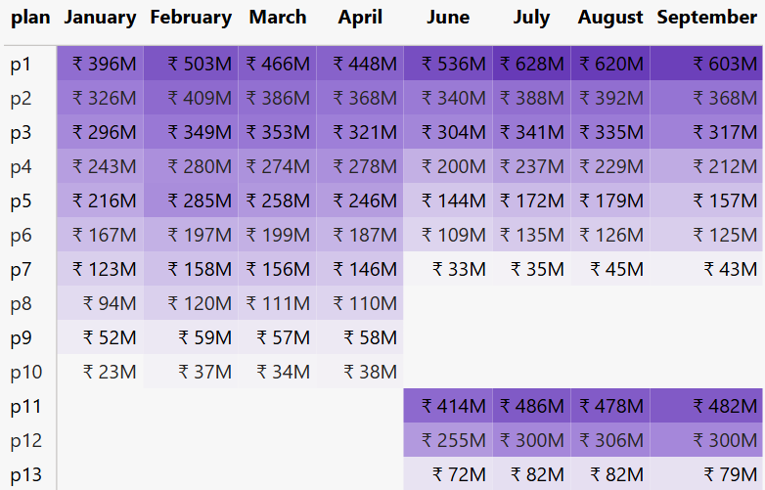
5.Is there any plan that is discontinued after the 5G launch? What is the reason for it?
In June, Wavecon introduced its 5G service
Plans for p8, p9 and p10 have been discontinued after 5G launch
P8, p9, and p10 contributed to only 5%, 2.6%, and 1.5% respectively of the total revenue
Reason is not having much revenue from these plans as compared to rest plans and not in high demand among customers

Slide 12
RECOMMENDATIONS
Investigate revenue decline in Delhi, Chennai, and other affected cities through customer surveys and competitive analysis.
Retain active users in Delhi & Mumbai by improving service quality, offering targeted discounts, and addressing complaints.
Analyze high unsubscription in Lucknow to identify dissatisfaction factors and reduce churn.
Optimize plan offerings by promoting high-performing plans (P1), revising low-performing ones (P7), and monitoring new plans (P11-P13).
Enhance 5G network quality in affected areas and offer exclusive benefits to retain at-risk users.

Slide 13


